Slide 1
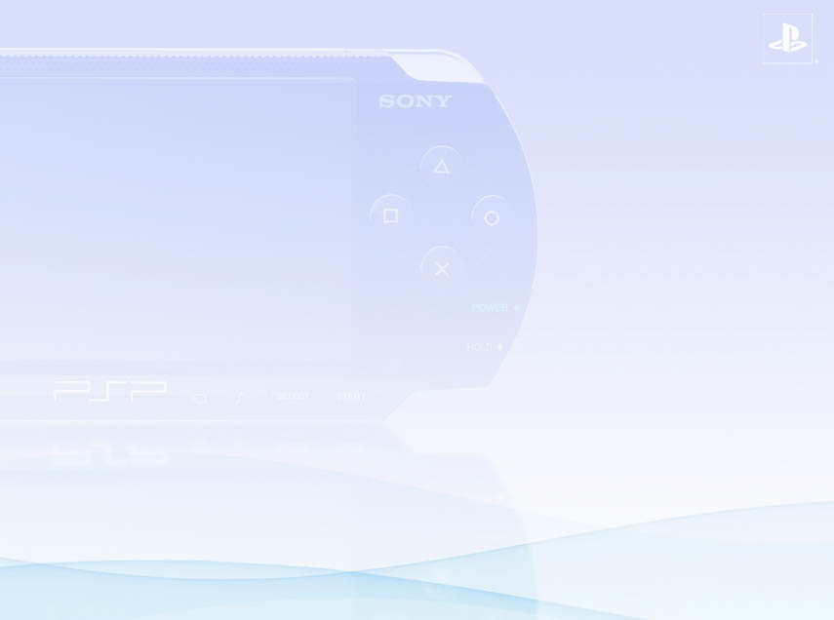
Graphics and VFPU programming on PSPTM
For the technical minded and the impact
for the non technical minded
Sébastien Rubens, SCEI Euro R&D

Slide 2
Goal of this presentation
Give an idea of PSPTM (present and future) programming issues
Give an idea of PSPTM programming constraints
What could be PSPTM games in the future
Software development (in general)

Slide 3
Coming up…
PlayStation NDA reminder
Memory latency
Graphics
(Graphics Engine and graphics library)
COLLADA
VFPU
System optimization
Conclusions
[Note: the presentation has additional comments]

Slide 4

PlayStation NDA reminder
You are not allowed to
  Discuss about any PS1/PSP/PS2/PS3 technical information with non licensed developers
  Post any confidential information on the web or hacking/game forums
Your responsibility is
  Protect your console and your job!
  Be careful with the material you give to the public (internal/external conferences)
  To strip the debug symbol from your executable

Slide 5
IMPORTANT
All measures are subject to potential accuracy problems depending on:
The interruption manager
The profiler
Display-list synchronisation used in the interruption manager
Graphic Engine pipeline

Slide 6
Memory latency

Slide 7
Memory latency (1)
Memory is slow, on PSPTM
  RAM latency @222MHz ~ 61/76cy (page break)
  VRAM latency @222MHz ~ 43/45cy
  SPad latency @222MHz ~ 37cy
  RAM
    “14.5 M inst/s if there is cache misses all the time”
    = “240K line of ASM code per vbl”
    ~ “number of words on a 50 pages newspaper!”
Loading/Saving more data at once
  CPU uncached access = 4 bytes
  VFPU uncached access = 16 bytes
  CACHE accesses = 4*128bytes
  = 64 bytes (see sceePspGu)
  CACHE writes with “dirty exclusive” avoid cache refill
Notes:
The numbers for the memory latency come from practical tests made mid-2004. These tests could be more accurate today using the profiler.
14.5M inst/s correspond to 222MHz / 61cy * 4 instructions loaded at the same time (128bits).
This should be compared with the 1.776Gflops/s as a peak performance in theory: 14.5M vs 1776M → The bottleneck is the memory!
240K correspond to 14.5M / 60 frames per second
50 pages is an estimation based on a French newspaper (I expect less pages in English).
These number seems to be very small to run a complete game and proves the main bottleneck on the PSPTM system (like any system) is the memory bandwidth.
CPU uncached memory access read/write 4 byte (32-bit) at the same time.
VFPU uncached memory access read/write 16 byte (128-bit) at the same time.
Cache accesses write/read 4 qwords (4*128-bit) at the same time (sceePspGu can use cached accesses for display lists).
Cached writes could be accelerated by using (if applicable) the cache instruction and “create dirty exclusive” (to avoid cache refill).

Slide 8
Memory latency (2)
Minimize memory accesses (see vfpu patch)
  Keep data in registers (“register” keyword)
  Don’t uses pointers everywhere (reinterpret_cast!)
  Use argument by value for vectors (not pointers)
  Don’t forget pointer to constant (const Stuff*)
Data structure must avoid random accesses
  Minimize cache misses (CPU/VFPU)
  Minimize page break (CPU/VFPU/Graphic Engine)
    code/data are in the cache = less contention problem between the cpu/vfpu and the Graphic Engine
  Algorithm / (software) tools problem
Notes:
Minimize memory accesses
“register” can be ignored by some compilers and on some others, it can help. It does not harm anybody to not use it.
Passing data by pointer can be badly optimized by some compilers (there is a note concerning reinterpret_cast in the vfpu asm patch/intrinsic documentation).
Using “vector by value” as argument of a function produces, in general, better code on a simd processor.
Pointer to constant structure or class can be optimized more easily by the compiler (and it makes a code more constrained with a better programming style).
Data structure must avoid random accesses
It minimizes the cache misses, which has an impact on the CPU and the VFPU (the cache is located in the processor, and VFPU cache accesses use the Allegrex cache)
It minimizes the page breaks, which has an impact on the CPU, the VFPU and the Graphic Engine (the page are located in the memory and the memory is accessed from the Allegrex, the VFPU for the Graphic Engine)
To minimize memory accesses and especially page break, or to simply prefetch the data from the memory to the cache while the processor doesn’t access the memory, it is very helpful to have predictable memory accesses.
Of course, it is not simple but it could be optimized by:
Changing the algorithms to read sequential data, but it is not always possible,
Creating a tool to optimize memory accesses, for a specific algorithm.
These kind of optimizations will be probably presented in a future document.

Slide 9
Memory latency (3)
Consequences for non programmers
  Memory optimization requires technical knowledge
    Ex: optimal texture size and delta s/t?
      Must be properly documented
      A (automatic) software tool is better to do the job
    Vertex format vs precision vs DMA accesses
      Impossible to optimize manually for all the object database
      A (automatic) software tool is better to do the job
  Tools help artists/designer to focus on content but not on Geeky stuffs!
    Collada optimization/transformation modules could do the job
Consequences for games
  Better memory usage =
  Better performances or nicer games
Notes:
Consequences for non programmers
memory optimization requires a technical knowledge (how works the hardware in general, the graphic chipset, the cpu, bus, in particular).
Example: the texture coordinates of the vertexes of a triangle have an impact on the texture cache (it can create cache misses), they depend on how the gpu prefetch the texels.
It means hardware must be well documented but, sometimes, the hardware is not fully documented because of intellectual property issues.
An optimization tool is better to do the job: it just have to minimize a cost function and the job can be done automatically, artists don’t have to change their data for a new optimization, and everybody can benefit of the latest discoveries.
Vertex format has an impact on performance (bus occupation), and for the same precision (precision of data, or precision really used by the hardware) smaller vertex format can be found
[example: internal Ge computation are only in 24bits it means only 16-bit of the mantissa are used for vertex coordinates, it means vertex coordinates could be send as integer and the exponent could be replaced by a scale on the transform matrix]
It is very long (impossible financially speaking?) to set manually the parameter of all the game data (non-supervised optimization methods are helpful)
Once again, this job is repetitive, has deterministic criteria: that is the role of a computer, not a human being!
Conclusions: I prefer to see an artist working on content, not technical problems!
Collada optimization/transformation modules could do these jobs
Consequences for games
Better memory usage means less bus bandwidth, means better performances you could use to improve the game (more graphics, better gameplay…).
I would to point out that these problems are not specific to the PSPTM.

Slide 10
Graphics
Graphics Engine
Graphics Library

Slide 11
Graphics (1)
Introduction
For the programmer
  PSPTM can be programmed using a high level API, or
  PSPTM can be programmed using a low level
  “ps2 programming style”
  This API is NOT OpenGL®
  Graphics Engine internal computations: 24-bit
For the artist
  PSPTM graphics capacities are limited
  don’t expect to do PS3 games on it!
PSPTM = PlayStation Portable
PSPTM != “big portable PC @ 20GHz with NV147”
Notes:
This chapter is about graphic, and there is a few things to keep in mind when programming on PSPTM.
For the programmer, the “Graphic Engine or ligu is like OpenGL®”
The Graphic Engine and libgu have NOTHING TO DO with OpenGL®
Another important thing to keep in mind is the Graphic Engine has 24-bit internal computations
For the artists, the graphic capacities are limited, and they must not expect to have PS3 games on the PSPTM!
The PSPTM is a PORTABLE console, not a very big and expensive PC.

Slide 12
Graphics (2)
Coming up…
Vertex Format
VRAM organization
Fillrate
Fillrate & Vertex Transfer Speed
FullScreen AntiAliasing
Texture Coordinates Generation
sceePspGu
Notes:
The different point of this chapter are:
Vertex format
VRAM organization
Fillrate
Fullscreen AntiAliasing
Texture Coordinates Generation
sceePspGu

Slide 13
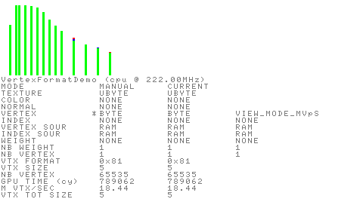
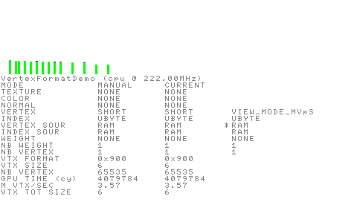
Graphics (3)
VertexFormat
Sample code: VertexFormatDemo
Remember: sequential accesses are better!
No vertex cache on PSPTM → indexed vertexes are not good
Non indexed
Indexed
~ 18.4 Mvtx/s
~ 3.6 Mvtx/s
Notes:
The first chapter shown us memory accesses are expensive (in general).
Remember: sequential accesses are better than random accesses.
The PSPTM has no vertex cache, it means indexed vertex are not good because we will do to much memory accesses, il will slow down the Graphic Engine bus also the main CPU but multiplying bus requests:
Peak performances for non-indexed memory accesses are around 18.4M vertexes/s (lowest performances are around 6M vertexes/s).
Peak performances for indexed memory accesses are around 3.6M vertexes/s

Slide 14
Graphics (4)
VertexFormat
Vertex transfer speed depend on vertex size
→ DMA charge depend on vertex size!
smaller vertex size = quicker
(except VERTEX_BYTE)
Bigger vertex size = slower
Notes:
Vertex transfer speed depend on vertex size: if you transfer more sequential data, you will do more memory accesses:
Peak performances for non-indexed memory accesses are around 18.4M vertexes/s (TEXTURE_BYTE|VERTEX_BYTE, vertex size = 5)
lowest performances are around 6M vertexes/s (TEXTURE_FLOAT|COLOR_CF8888|NORMAL_FLOAT|VERTEX_FLOAT, vertex size = 6)

Slide 15
Graphics (5)
VertexFormat
Can optimize data transfer by finding the quickest “equivalent” vertex format! (= tool)
Floats can be changed to SHORT since the Ge only reads 16-bit in the mantissa (→ exponent is moved to the transform matrix)
Could be done with Collada optimization modules?
TEXTURE_BYTE|VERTEX_BYTE
VERTEX_BYTE
Notes:
It can be possible to optimize your data by optimizing finding the quickest “equivalent” vertex format, as explaining in “memory latency (3)”: it is a tool job.
Float vertex coordinates can be changed to short since it appears the Graphic Engine ignores the lowest 8-bit of the float (lowest 8-bit of the mantissa).
It could be done with Collada optimization modules.
If you want to test some specific vertex format, the sample code is provide with sceePspGu 1.1.

Slide 16
Graphics (6)
VRAM organization
Sample code: AddrTransDemo
VRAM = 1024-page x 32 column x 128-bit x 2 bank memory macros…
… decomposed in Col and Row (0.3.0, chapter 22.3)
  Linear mode
  Graphics mode
→ 1 bank = 32 rows (512 bytes)
That is the theory…
In practice, sceGeEdramSetAddrTranslation() seems to control the VRAM organization
20 |  |  |  |  |  |  |  |  | 11 | 10 | 9 | 8 |  |  |  | 4
Col[9:0] |  |  |  |  |  |  |  |  |  | M | Bx | Row[4:0]
20 | 19 | 18 | 17 | 16 | 15 | 14 | 13 | 12 | 11 | 10 | 9 | 8 | 7 | 6 | 5 | 4
Row[9:3] |  |  |  |  |  |  | Bx | Col[4:2] |  |  | Row[2:0] |  |  | M | Col[1:0]
Notes:
To continue with memory accesses, let us have a look at the VRAM organization.
The VRAM organization is described in manual 0.3.0, it has 1024-page x 32 column x 128-bit (per column) x 2 banks
According to the “Graphics Engine – Users Manual” , the VRAM is decomposed on Columns and Rows, and has two modes: linear mode and graphics mode
1 bank has 32 row which means 512 bytes
That is the theory, because…
… in practice, sceGeEdramSetAddrTranslation() seems to control the VRAM organization (when I did fillrate tests last year ago, I realised sceGeEdramSetAddrTranslation() had an impact on the fillrate)

Slide 17



Graphics (7)
VRAM organization
sceGeEdramSetAddrTranslation(1024) is set by default
The correspond device/bank organization for 16bits screen:
  DrawBuffer
  zBuffer
Memory devices/Banks are swapped to optimize memory accesses
Memory device 0, bank 0
Memory device 0, bank 1
Memory device 1, bank 0
Memory device 1, bank 1
Notes:
Let me take some examples…
sceGeEdramSetAddrTranslation(1024) is the value by default.
For a 16-bit screen, we have the following memory device/bank organization.
I draw pixel using graphics mode, and then, switch back to linear and colorize the pixel depending on their coordinates and their address in linear mode (the sample code is provide with sceePspGu 1.1).
Memory devices and banks are swapped to optimize memory accesses

Slide 18


Graphics (8)
VRAM organization
16-bit screen with sceGeEdramSetAddrTranslation(2048)
  DrawBuffer
  zBuffer
The banks are stretched vertically
  odd lines will be in one row
  even lines will be in another row (but in the same bank number)
Performances should drop
Notes:
If we keep the same 16-bit screen and change set the address translation to 2048, we have the following screen organization
The banks are stretched vertically
Odd lines will be in one Row
Even lines will be in another Row (but in the same bank number)
The performances should drop

Slide 19


Graphics (9)
VRAM organization
32-bit screen with sceGeEdramSetAddrTranslation(1024)
  DrawBuffer
  zBuffer
The banks are split horizontally
Performances should slightly drop when clearing the screen
  You can notice the bank width is divided by 2
Notes:
If we change the screen pixel format to 32-bit, and use the default address translation (1024), we have the following screen organization
The banks are split horizontally
The performances should slightly drop when clearing the screen
You can notice the bank width is divided by 2

Slide 20


Graphics (10)
VRAM organization
32-bit screen with sceGeEdramSetAddrTranslation(2048)
  DrawBuffer
  zBuffer
The bank are not split
Performances should be maximum without zBuffer
Performances should be slower with zBuffer
Notes:
If we keep the screen pixel format to 32-bit, and change the default address translation to 2048, we have the following screen organization
The organization is more optimal
The banks are not split
Performances should be maximum without zBuffer
Performances should be slower with zBuffer

Slide 21
Graphics (11)
VRAM organization
Implications (1)
  sceGeEdramSetAddressTranslation() change the whole memory map, therefore, it should be set once for the whole game
  When render to a texture, it could be good to have
  textureWidth (in bytes) = addrTranslation (in bytes)
  When clearing the screen
    64 pixels wide rectangles are optimal for 16-bit screen
    32 pixels wide rectangles are optimal for 32-bit screen
Notes:
Implication (1)
sceGeEdramSetAddressTranslation() change the whole memory map, therefore, it should be set once for the whole game
When render to a texture, it could be good to have textureWidth (in bytes) = addrTranslation (in bytes)
When clearing the screen
64 pixels wide rectangles are optimal for 16-bit screen
32 pixels wide rectangles are optimal for 32-bit screen

Slide 22
Graphics (12)
VRAM organization
Implications (2)
  The “optimal polygon size” is "bank width * bank height”
    32 pixel width polygon should be optimal for 16-bit screen
    16 pixel width polygon should be optimal for 32-bit screen
  If polygon width is bigger than the “optimal polygon size”, the Graphic Engine will stall mainly on VRAM memory accesses
  FSAA should be “not so much expensive” if the scene uses polygons with the “optimal polygon size” (next…)
Notes:
Implications (2)
The “optimal polygon size” is "bank width * bank height”
32*8 polygon should be optimal for 16-bit screen (if address translation = 512*2)
16*8 polygon should be optimal for 32-bit screen (if address translation = 512*4)
If polygon width is bigger than the “optimal polygon size”, the Graphic Engine will stall mainly on VRAM memory accesses
FSAA should be not so much expensive if the scene uses polygons with the “optimal polygon size”

Slide 23
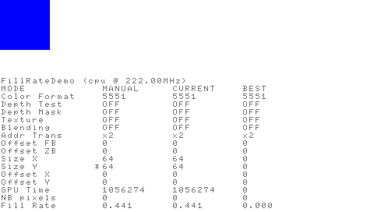
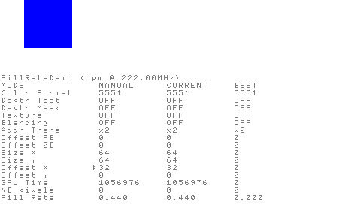
Graphics (13)
Fillrate
Sample code: FillrateDemo
Fillrate @ 111MHz = 0.444 G pixels/s (theory)
Depend on VRAM organization (sceGeEdramSetAddressTranslation())
Fillrate is preserved by horizontal
translation equal to bank width
(in pixels)
Example:
  1 bank = 32 pixels width (5551)
  Optimal width = 64 pixels (5551)
Notes:
Now, let me talk about the fillrate…. Just to continue with memory accesses, I know you like it! ☺
In theory, @ 111MHz, the maximum fillrate is 0.444 G pixels/s
It depends on VRAM organization (sceGeEdramSetAddressTranslation())
Fillrate is preserved by horizontal translation equal to bank width (in pixels), here
Example:
1 bank = 32 pixels width (5551)
Optimal width = 64 pixels (5551)

Slide 24
Graphics (14)
Fillrate
FillrateDemo confirms the previous “VRAM organization implications”
When clearing 32-bit screen, sceePspGu uses 16 pixel width rectangles
(there is probably some contention between the zbuffer and framebuffer)
 | addrTrans | zBuf OFF | zBuf ON | Comments
16-bit | 1024 | 0.441, 64*64 (64 = width of 2 banks) | 0.432, 64*8 (8 = height of bank) | Optimal for 16bits
32-bit | 2048 | 0.405, 32*64 (32 = width of 2 banks) | 0.388, 32*8 (8 = height of bank) | Optimal for 32bits
32-bit | 1024 | 0.403, 32*64 (32 = width of 2 banks) | 0.375, 32*4 (4 = height of bank) | Not Optimal but quicker than 16bits (2048), as expected
16-bit | 2048 | 0.375, 64*64 (64 = width of 2 banks) | 0.371, 64*16 (16 = width of 2 banks but banks are stretched vertically) | Slowest mode, as expected
Notes:
FillrateDemo confirms the previous “VRAM organization implications”.
(………….)
If you want to do your own tests, FillrateDemo sample code is provided with sceePspGu 1.1.

Slide 25
Graphics (15)
Fillrate
Implications
  Big polygons (width greater than the polygon size) can slow down the drawing
    It creates row breaks
    Performances can divided by a number in the interval [2, 4]
  Polygons with width greater than 9 pixels start to be efficient
  (fillrate > 0.3Gpix/s)
  Small polygons are not efficient
    The drawing probably stalls on the vertex format
      see Fillrate Vertex Transfer Speed (next)
  Texture cache misses can also penalize drawing
  We could evaluate the performance of a model using software tools
    Model optimization will be multicriteria
    Hard to find “manually” (need software tools)
Notes:
Implications
Big polygons (width greater than the polygon size) can slow down the drawing
It creates row breaks
Performances can divided by a number of the interval [2, 4]
Polygons with width greater than 9 pixels start to be efficient (fillrate > 0.3Gpix/s)
Small polygons are not efficient
The drawing probably stalls on the vertex format
see Fillrate Vertex Transfer Speed (next)
Texture cache misses can also penalize drawing
We could evaluate the performance of a model using software tools
Model optimization will be multicriteria
Hard to find “manually” (need software tools)

Slide 26
Graphics (16)
Fillrate & Vertex Transfer Speed
We would like to find a relation between
  The fillrate (and the memory organization)
  The vertex transfer speed
  But we will ignore the T&L
We choose a primitive
  Equilateral triangle
  An edge size for the triangle
We compute
  The maximum number of triangle to be drawn depending on the maximum fillrate (0.444Gpix/s @ 111Mhz)
The maximum triangle width on the screen is equal to the triangle edge size
Notes:
We would like to find a relation between
The fillrate (and the memory organization)
The vertex transfer speed
But we ignore the T&L
We choose a primitive
Equilateral triangle
An edge size for the triangle
We compute
The maximum number of triangle to be drawn depending on the maximum fillrate (0.444Gpix/s @ 111Mhz)
The maximum triangle width on the screen is equal to the triangle edge size

Slide 27
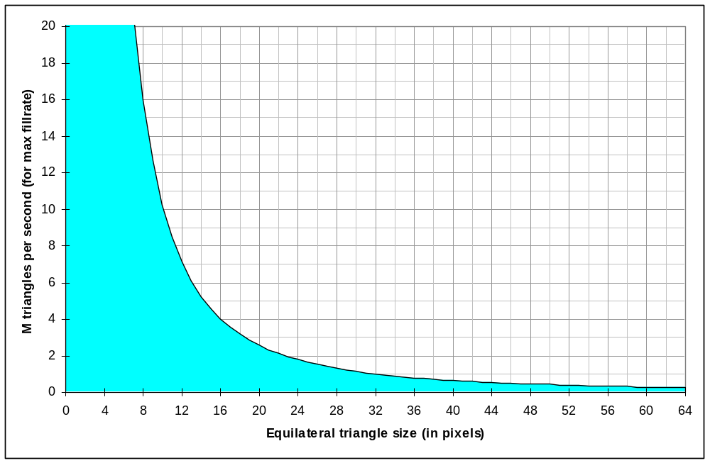
Graphics (17)
Fillrate & Vertex Transfer Speed
Millions of triangles per second, for a 0.444 Gpix/s fillrate
  Depending on a triangle size
Stall on fillrate
No stall on fillrate
Could stall on vertex transfer
Notes:
Here is a curve of the millions of triangle per second you can expect for a typical triangle size with the maximum fillrate (0.444Gpix/s).
The white part (top of the curve) is when the Graphic Engine stalls on the fillrate
The blue part (below the curve) is when the Graphic Engine does not stall on the fillrate.

Slide 28
Graphics (18)
Fillrate & Vertex Transfer Speed
“Usable” size @ 111Mhz
Impossible
(because of DMA)
“Usable” size
Notes:
The Graphic Engine cannot have performances greater than 18.5M vertexes per second at 111Mhz.
We consider this perfomances impossible to reach in a real game.

Slide 29
Graphics (19)
Fillrate & Vertex Transfer Speed
“Optimal” size for 16-bit screen
  Equilateral triangles with a width lower than 32
Row breaks
“Optimal” size
Greater than “optimal” polygon size
Notes:
When using polygon with optimal size for 16-bit screen, we limit our possibilities.
It is important to not that when exceeding the optimal polygon size, the fillrate drop by [2,4] (a number in the interval [2,4]).

Slide 30

Graphics (20)
Fillrate & Vertex Transfer Speed
“Optimal” area for 16-bit screen
  Equilateral triangles with a width lower than 32
Row breaks
“Optimal” area
Greater than “optimal” polygon size
Notes:
In term of polygon surface, the optimal polygon surface is 443 pixels.

Slide 31
Graphics (21)
Fillrate & Vertex Transfer Speed
“Optimal” size for 32-bit screen
  Equilateral triangles with a width lower than 16
Row breaks
“Optimal” size
Greater than “optimal” polygon size
Notes:
When using 32-bit screen, we reduce our optimal performances area.

Slide 32
Graphics (22)
Fillrate & Vertex Transfer Speed
“Optimal” area for 32-bit screen
  Equilateral triangles with a width lower than 16
Row breaks
“Optimal” area
Greater than “optimal” polygon size

Slide 33
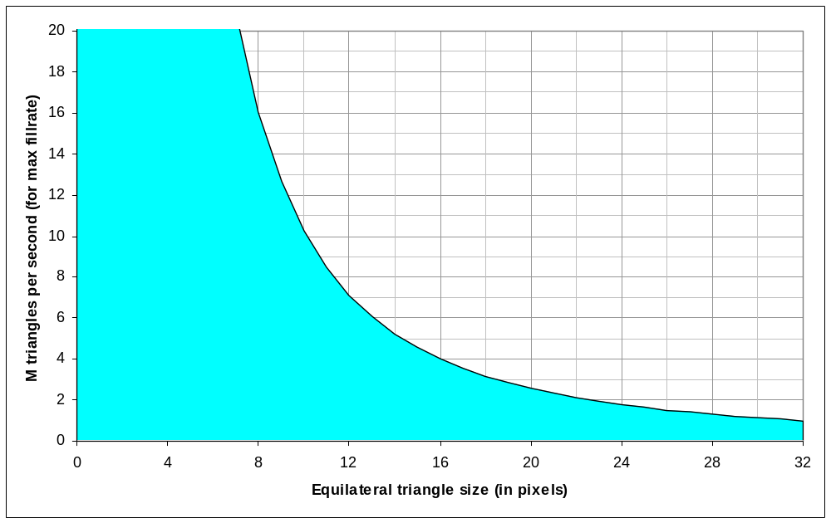
Graphics (23)
Fillrate & Vertex Transfer Speed
What about Vertex Format size?
Stall on fillrate
No stall on fillrate
stall on vertex transfer
vertex size = 20
No stall on fillrate
No stall on vertex transfer
Notes:
Now, if we consider the vertex size, we can reduce our investigation area by limiting it to the vertex transfer speed.
Here is a simple vertex of size 20 bytes (any combination of texture coordinates / colour / normals / position).

Slide 34
Graphics (24)
Fillrate & Vertex Transfer Speed
All Vertex Format size?
5/6/8
10
12/14
16
3
18
20
24
28
32
36
Notes:
Here is a representation of all possible vertex sizes for “simple vertexes” (any combination of texture coordinates / colour / normals / position).

Slide 35
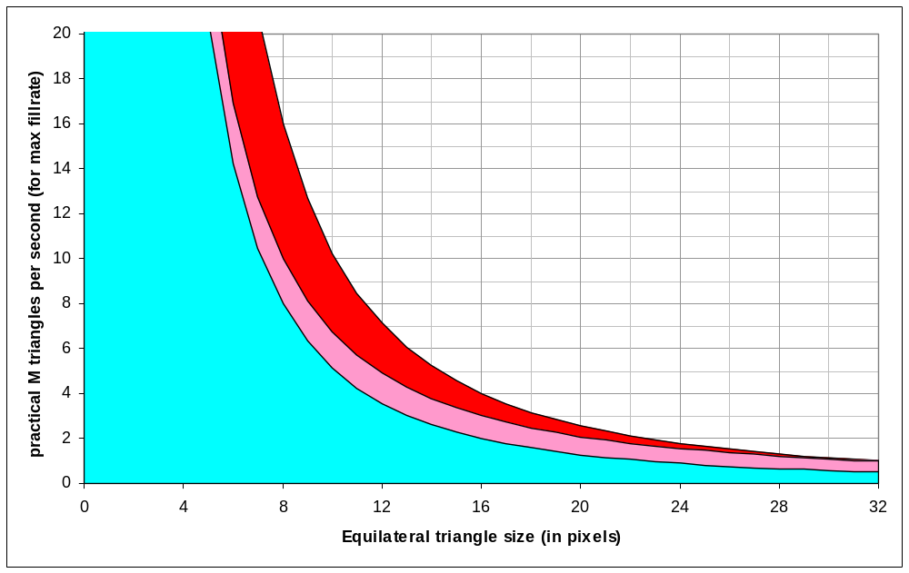
Graphics (25)
Fillrate & Vertex Transfer Speed
In practice?
Polygons are triangles
Fillrate is optimal or half
the maximum fillrate (comments)
5/6/8
10
12/14
16
3
18
20
24
28
32
36
Stall on fillrate
(2 hypothesis)
Notes:
In practice, we can expect to have half of the fillrate:
Because polygons are triangles rather than rectangles (probably more optimal)
Fillrate is optimal when polygons are close to the optimal size
Two hypothesis:
The fillrate is almost optimal close to the optimal size (here, we supposed the optimal size is 32) and half the speed for smaller polygon
The fillrate is half the maximum fillrate everywhere because triangle cannot be optimal everywhere and we can use a “security” margin

Slide 36
Graphics (25-26)
Fillrate & Vertex Transfer Speed
Bus charge???
5/6/8
10
12/14
16
3
18
20
24
28
32
36
Notes:
In practice, we can expect to have half of the fillrate:
Because polygons are triangles rather than rectangles (probably more optimal)
Fillrate is optimal when polygons are close to the optimal size
Two hypothesis:
The fillrate is almost optimal close to the optimal size (here, we supposed the optimal size is 32) and half the speed for smaller polygon
The fillrate is half the maximum fillrate everywhere because triangle cannot be optimal everywhere and we can use a “security” margin

Slide 37
Graphics (26)
Fillrate & Vertex Transfer Speed
Bus charge???
Maximum vertex
transfer will drop at least
proportionally to the bus charge
5/6/8
10
12/14
16
3
18
20
24
28
32
36
Notes:
Implications
We “studied” the interaction between fillrate and vertex transfer…
In real world, we have an interaction between
Fillrate
Vertex transfer
T&L
Bus charge (processor and other coprocessors)
Texture cache fetch (same kind of problem as fillrate)
Texture cache in VRAM also break VRAM rows…
Issues with FSAA
Issues with Render to texture in VRAM
…
We will have stalls very quickly
Fillrate stalls should be more interesting than vertex transfer stalls
Once again, there is method to help
And the key of optimisation will be on the software side

Slide 38
Graphics (27)
Fillrate & Vertex Transfer Speed
Implications
  We “studied” the interaction between fillrate and vertex transfer…
  In real world, we have an interaction between
    Fillrate
    Vertex transfer
    T&L
    Bus charge (processor and other coprocessors)
    Texture cache fetch (same kind of problem as fillrate)
    Texture cache in VRAM also break VRAM rows…
      Issues with FSAA
      Issues with Render to texture in VRAM
      …
  We will have stalls very quickly
    Fillrate stalls should be more interesting than vertex transfer stalls
Once again, there are methods to help
  And the key of optimisation will be on the software side
  It is not a simple work!
Notes:
Implications
We “studied” the interaction between fillrate and vertex transfer…
In real world, we have an interaction between
Fillrate
Vertex transfer
T&L
Bus charge (processor and other coprocessors)
Texture cache fetch (same kind of problem as fillrate)
Texture cache in VRAM also break VRAM rows…
Issues with FSAA
Issues with Render to texture in VRAM
…
We will have stalls very quickly
Fillrate stalls should be more interesting than vertex transfer stalls
Once again, there is methods to help
And the key of optimisation will be on the software side
It is not a simple work!

Slide 39
Graphics (28)
Full-Screen Anti-Aliasing
Sample code: FSAADemo
(“AntiAliasing, supersampling”, AGDC 2004)
Fillrate
  56 screen (480*272) @ 60Hz
  30 screen (512*480) @ 60Hz
  7M pixels/frame (to compare with T&L)
AA ratio
  (512x480) / (480x272) = 1.88
  1.88:1 supersampling
Notes:
This part is related to the sample code: FSAADemo (“AntiAliasing, supersampling”, AGDC 2004)
An important notion to have in mind is the number of screen you can fill per frame (Fillrate):
56 screen (480*272) @ 60Hz
30 screen (512*480) @ 60Hz
7M pixels/frame (to compare with T&L)
AA ratio
(512x480) / (480x272) = 1.88
1.88:1 supersampling

Slide 40
Graphics (29)
Full-Screen Anti-Aliasing
IMPORTANT
  It seems very hard to start an interruption and stop the display list at the same time
  To have “coherent measures”, dummy display commands were added to have “coherent” timings
Notes:
IMPORTANT
It seems very hard to start an interruption and stop the display list at the same time
To have “coherent measures”, dummy display commands were added to have “coherent” timings

Slide 41
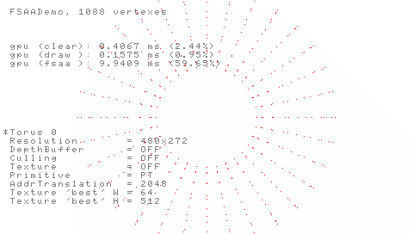
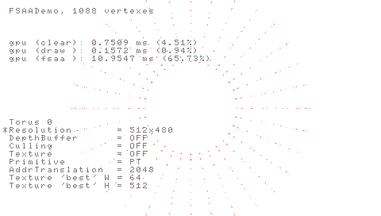
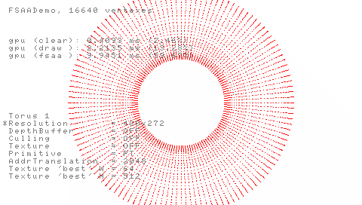
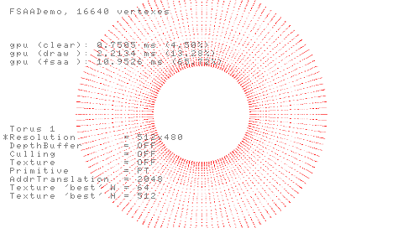
Graphics (30)
Full-Screen Anti-Aliasing
PRIM_POINTS 480x272
  1088 vertexes: 0.15ms
  16640 vertexes: 2.21ms
PRIM_POINTS 512x480
  1088 vertexes: 0.15ms
  16640 vertexes: 2.21ms
x1
x14
x14
x1
Notes:
Here different measures:
Two differents objects: 1088 vertexes and 16640 vertexes, but almost the same shape / area.
Two differents resolutions: 480*272 (a normal screen), 512*480, a bigger screen (~ 1.88 times bigger)

Slide 42
Graphics (31)
Full-Screen Anti-Aliasing
Performances analysis
According to VertexFormatDemo
  TEXTURE_FLOAT|NORMAL_FLOAT|VERTEX_FLOAT ~ 7.20 MVtx/s
  1088 vtx / 7.20 Mvtx/s ~ 0.15ms
  16640 vtx / 7.20 Mvtx/s ~ 2.31ms
Performances @ 480x272
  1088 vtx ~ 0.15ms
    Stalls on vertex transfer
  16640 vtx ~ 2.21ms
    Stalls on the vertex transfer (very close to 2.31ms)
Performances @ 512x480
  1088 vtx ~ 0.15ms
    Stalls on vertex transfer
  16640 vtx ~ 2.21ms
    Stalls on the vertex transfer (very close to 2.31ms)
Number of points
  Object is 14 slower with 16640 vertexes (16640 /1088 = 15.29)
Notes:
Performances analysis
Here is some numbers to help to understand…
According to VertexFormatDemo
I could be possible to transfer ~ 7.20 MVtx/s of the following vertex format TEXTURE_FLOAT|NORMAL_FLOAT|VERTEX_FLOAT (the one used in this sample code)
It gives uses a transfer time of ~ 0.15ms for 1088 vtx
It gives uses a transfer time of ~ 2.31ms for 16640 vtx
Performances @ 480x272
1088 vtx ~ 0.15ms
Stalls on vertex transfer
16640 vtx ~ 2.21ms
Stalls on the vertex transfer (very close to 2.31ms)
Performances @ 512x480
1088 vtx ~ 0.15ms
Stalls on vertex transfer
16640 vtx ~ 2.21ms
Stalls on the vertex transfer (very close to 2.31ms)
Number of points
Object is 14 slower with 16640 vertexes (16640 /1088 = 15.29)

Slide 43
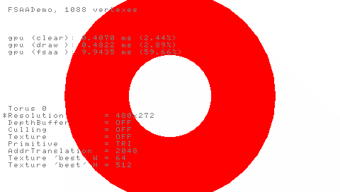
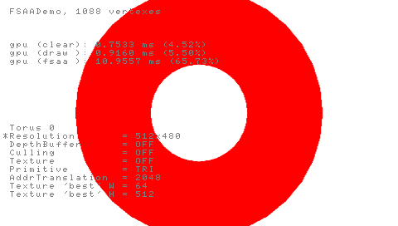

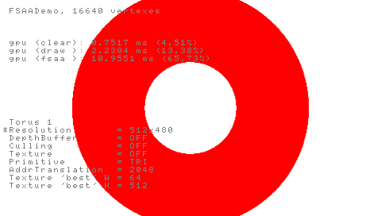
Graphics (32)
Full-Screen Anti-Aliasing
PRIM_POINTS 480x272
  1088 vtx: 0.48ms (0.15)
  16640 vtx: 2.21ms (2.21)
PRIM_POINTS 512x480
  1088 vtx: 0.91ms (0.15)
  16640 vtx: 2.23ms (2.21)
x1.9
x4.06
x2.45
x1.01
Notes:
Now, we just change the primitive to triangle strip to fill the polygon (without ztest or zwrite, without culling, without texture…)

Slide 44
Graphics (33)
Full-Screen Anti-Aliasing
Performances analysis
1088 vertex model
  The model has dispersed vertex, drawing should stalls on filllrate
  480x272: 0.48ms with filling versus 0.15ms without filling (ratio ~3.2)
  512x480: 0.91ms with filling versus 0.15ms without filling (ratio ~6.06)
  The object has not a lot of vertexes
    When using filling: big penalties on filling
    Filling with an higher resolution: more penalties (6.06 vs 3.2)
  0.91ms / 0.48ms = 1.9 (AA ratio = 1.88)
    Greater than the AA ratio (row breaks?)
16640 vertex model
  The model has non dispersed vertex: it should stalls on transfer
  480x272: 2.21ms with filling versus 2.21 without filling (ratio ~1)
  512x480: 2.23ms with filling versus 2.21 without filling (ratio ~1.01)
  Drawing is not stalling on fillrate, but on fillrate
  2.23ms / 2.21ms = 1.01 (AA ratio = 1.88!!!)
Number of points
  480x272: Object is 4.06 time slower (fillrate stalls for 1088 vertexes)
  512x480: Object is 2.45 time slower (better ratio!)
Notes:
Performances analysis
1088 vertex model
The model has dispersed vertex, drawing should stalls on filllrate
480x272: 0.48ms with filling versus 0.15ms without filling (ratio ~3.2)
512x480: 0.91ms with filling versus 0.15ms without filling (ratio ~6.06)
The object has not a lot of vertexes
When using filling: big penalties on filling
Filling with an higher resolution: more penalties (6.06 vs 3.2)
0.91ms / 0.48ms = 1.9 (AA ratio = 1.88)
Greater than the AA ratio (row breaks?)
16640 vertex model
The model has non dispersed vertex: it should stalls on transfer
480x272: 2.21ms with filling versus 2.21 without filling (ratio ~1)
512x480: 2.23ms with filling versus 2.21 without filling (ratio ~1.01)
Drawing is not stalling on fillrate, but on fillrate
2.23ms / 2.21ms = 1.01 (AA ratio = 1.88!!!)
The important thing is AA ratio is 1.88 but the drawing speed is the same.
Number of points
480x272: Object is 4.06 time slower (fillrate stalls for 1088 vertexes)
512x480: Object is 2.45 time slower (better ratio!)

Slide 45
Graphics (34)
Full-Screen Anti-Aliasing
FSAA strategies (1)
Clear screen
  480x272 = 0.41 ms [theory (480x272)/0.444G = 0.294ms]
  512x480 = 0.75 ms [~ (512x480)/(480x272) x 0.41ms]
  512x292 = 0.48 ms [~ (512x292)/(480x272) x 0.41ms]
  Time is proportional to the area to clear
Difference between clearing and super-sampling
  Clearing: Write only to frame buffer / depth buffer
  AA: Read “AA ratio x nbPixelScreen” texels
  + Write “nbPixelScreen” pixels
  = Read or Write “(1 + AA ratio) x nbPixelScreen”
Ideal anti-aliasing
  For a clearing time tc
  For an anti-aliasing time taa
  We would like to have taa = tc x (1 + AA ratio) * nbPixelScreen
Notes:
FSAA strategies (1)
To give an idea of the performances we have, we must at first study what is the speed to clear a “standard” PSPTM screen.
Clear screen
480x272 = 0.41 ms [theory (480x272)/0.444G = 0.294ms]
512x480 = 0.75 ms [~ (512x480)/(480x272) x 0.41ms]
512x292 = 0.48 ms [~ (512x292)/(480x272) x 0.41ms]
Time is proportional to the area to clear
Difference between clearing and super-sampling
Clearing: Write only to frame buffer / depth buffer
AA: Read “AA ratio x nbPixelScreen” texels
+ Write “nbPixelScreen” pixels
= Read or Write “(1 + AA ratio) x nbPixelScreen”
Ideal anti-aliasing
For a clearing time tc
For an anti-aliasing time taa
We would like to have taa = tc x (1 + AA ratio) * nbPixelScreen

Slide 46
Graphics (35)
Full-Screen Anti-Aliasing
FSAA strategies (2)
Strategy 1
  Big sprite to reduce screen to itself
  480x272 → 480x272 = 9.94 ms (we could expect 0.82)
  512x480 → 480x272 = 10.95 ms (we could expect 2.16)
  512x292 → 480x272 = 11.01 ms (we could expect 1.03)
  Time is not proportional to the area to down-sample
  Time is probably spent in texture cache refill or row contention
  (texture cache vs filling)
Strategy 2
  Screen reduced to itself, using sub rectangles to minimize row break
  480x272 → 480x272 = 1.62 ms (we could expect 0.82)
  512x480 → 480x272 = 2.73 ms (we could expect 2.16)
  512x292 → 480x272 = 1.81 ms (we could expect 1.03)
  Far quicker! But still not “optimal”…
Strategy 3?
  Is there any row access contention between texture cache vs filling?
  Optimization???
    Per rectangle :Prefetch texture cache and fill?
    Need more for information (or tests) about texture cache organization / update
Notes:
FSAA strategies (2)
Strategy 1
Big sprite to reduce screen to itself
480x272 → 480x272 = 9.94 ms (we could expect 0.82)
512x480 → 480x272 = 10.95 ms (we could expect 2.16)
512x292 → 480x272 = 11.01 ms (we could expect 1.03)
Time is not proportional to the area to down-sample
Time is probably spent in texture cache refill or row contention
(texture cache vs filling)
Strategy 2
Screen reduced to itself, using sub rectangles to minimize row break
480x272 → 480x272 = 1.62 ms (we could expect 0.82)
512x480 → 480x272 = 2.73 ms we could expect 2.16)
512x292 → 480x272 = 1.81 ms we could expect 1.03)
Far quicker! But still not “optimal”…
Strategy 3?
Is there any row access contention between texture cache vs filling?
Optimization???
Per rectangle :Prefetch texture cache and fill?
Need more for information (or tests) about texture cache organization / update

Slide 47
Graphics (36)
Full-Screen Anti-Aliasing
Conclusions
FSAA
  Time depend on the screen resolution and AA ratio
  Limited by memory contention
  (texture cache vs pixel drawing)
  Takes a constant time!
Optimization? (To be tested)
  Prefetch a rectangular area to the cache
    Require extra information in display list
    Transfer time vs texel fetching = what benefits?
    Efficiency depends on texture cache replacement algorithm
    (= need additional tests or better documentation)
  Require more tests!
    could be done quicker with better documentations
Notes:
Conclusions
FSAA
Time depend on the screen resolution and AA ratio
Limited by memory contention (texture cache vs pixel drawing)
Takes a constant time!
Optimization? (To be tested)
Prefetch a rectangular area to the cache
Require extra information in display list
Transfer time vs texel fetching = what benefits?
Efficiency depends on texture cache replacement algorithm (= need additional tests or better documentation)
Require more tests!
could be done quicker with better documentations

Slide 48
Graphics (37)
Texture coordinate generation
Sample codes:
MirrorDemo, TextureMatrixDemo, ToonShadingDemo
The PSPTM supports different methods of “texture coordinate generation”
The PSPTM does not support
  component independent texture coordinate generation
  SPHERE_MAP
  REFLECTION_MAP
  “PSPTM is not OpenGL®”!
Notes:
The PSPTM supports different methods of “texture coordinate generation”
The PSPTM does not support
component independent texture coordinate generation
SPHERE_MAP
REFLECTION_MAP
Is means the “PSPTM IS NOT OpenGL®”!
I am giving you some examples of what you can do with the PSPTM.

Slide 49
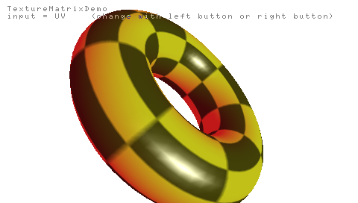
Graphics (38) texture coordinate generation
“Texture matrix” for UV coordinates
Notes:
You can use a “Texture matrix” to modify the UV coordinates.
You cannot see here, but the texture is animated.
You can apply a 4*3 matrix to the input coordinates, if means you can easily scale rotate and translate a texture.

Slide 50
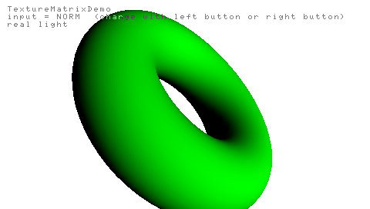

Graphics (39) texture coordinate generation
“Texture matrix” for NORM, NNORM
  Similar to OpenGL® “NORMAL_MAP”
  Example
    1 light
    Texture matrix to compute the
    same lighting using a light map
Notes:
You can use a “Texture matrix” to modify the normal or normalized normal coordinates.
It is similar to OpenGL® NORMAL_MAP.
For example:
I draw a torus with on parallel light and
I did the same lighting using a texture matrix to generates mapping coordinates in a light map.
It is not really a good example but it proves it works.

Slide 51
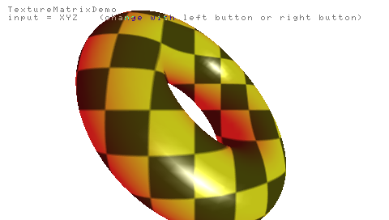
Graphics (40) texture coordinate generation
“Texture matrix” for XYZ
  Similar to OpenGL® “OBJECT_LINEAR” or “EYE_LINEAR”
  Can be used to project texture (shadow, light…)
Notes:
You can use a “Texture matrix” to modify XYZ coordinates.
It is similar to OpenGL “OBJECT_LINEAR” or “EYE_LINEAR” depending on the matrix you texture matrix set.
It can be used to project texture like shadow texture, light texture…

Slide 52

Graphics (41) texture coordinate generation
SHADE_MAP (“Toon Shading”, AGDC 2004)
  SHADE_MAP has nothing to do with SPHERE_MAP or REFLECTION_MAP!
  “Toon Shading”, AGDC 2004, can be done with shade mapping
  Graphics_Engine-Users_Manual-English.pdf,
  “Figure 13-2 Texture 1 for Shade mapping” is misleading!
    The texture can be used for ToonShading with reflection mapping
    The texture cannot be used for ToonShading using shade mapping
Notes:
SHADE_MAP (“Toon Shading”, AGDC 2004)
SHADE_MAP has nothing to do with SPHERE_MAP or REFLECTION_MAP!
“Toon Shading”, AGDC 2004, can be done with shade mapping
Graphics_Engine-Users_Manual-English.pdf, “Figure 13-2 Texture 1 for Shade mapping” is misleading!
The texture can be used for ToonShading with reflection mapping
The texture cannot be used for ToonShading using shade mapping

Slide 53
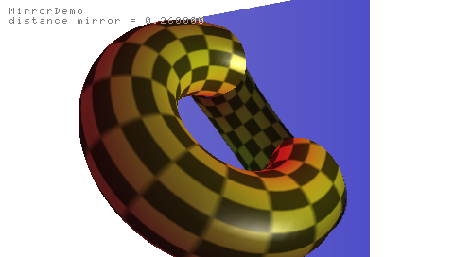
Graphics (42) texture coordinate generation
Reflection mapping?
  Possible if the surface is flat
  Non planar reflection: not possible with the Graphic Engine which does not compute the reflection vector
  (or it is very well hidden!)
Notes:
If you want to do reflection mapping, it is possible if the surface is flat by rendering the reflection to a texture (with a bit a projective matrix computation).
If the surface is non planar, it is not possible with Graphic Engine which does not compute the reflection vector.

Slide 54
Graphics (43) sceePspGu
Libgu/libgum improvement/replacement library
C++
  Strong types (typedef enum) + namespaces
  Use implicit parameters
♥
typedef enum
{
CW = 0,
CCW = 1
} EFrontFaceMode;
void FrontFace( EFrontFaceMode mode );
#define SCEGU_CW 0
#define SCEGU_CCW 1
void sceGuFrontFace( int mode );
void TexMapMode( ETextureMapMode map,
u32 lu,
u32 lv,
ETextureMapInput tmi = XYZ_INPUT );

Slide 55
Graphics (44) sceePspGu
Complete source code is provided + all the sample codes of this presentation are provided in sceePspGu 1.1 package!
Works
  with all compilers
    GCC, CW, ProDG
    Visual C.NET (for offline generation)
  Works with emulator, not provided (sorry)
2 modes
  Release and Debug (check validity of input parameters)
Supports
  ALLEGREX instructions (quick log2…)
  libgum-like VFPU code (different implementation)
    More functions:
    TexPerspective(), TexOrtho(), TexFrustum(), Invert43()
    VFPU code using ASM patch and intrinsics

Slide 56
Graphics (45) sceePspGu
Why switch?
  We source code to support and improve it
  You have the source code to improve it for your needs
  It supports the vpfu asm patch / intrinsics
  It is quicker than libgu (DepthBlur is quicker with sceePspGu, Clear is optimal with 32-bit screens, …)
  It has useful function for projective mapping
  You can use the library on PC to precompute your display lists
  You can specify multiple contexts for multiple display lists (one per texture?)
  Some useful utility functions will be added in the future
  …

Slide 57
Graphics (46) sceePspGu
libgu (1.5.2) vs sceePspGu (1.1.0) performances comparison for “depthBlur” sample
Similar pre-processor options were used
sceePspGu can be quicker
Measure Point | libgu | sceePspGu | libgu_vfpu | sceePspGu vfpu | sceePspGu vfpu patch
1 | 0.269 ms | 0.235 ms 12.6% faster | 0. 212 ms | 0.209 ms 1.4% faster | 0.212 ms same speed
2 | 0.430 ms | 0.327 ms 24% faster | 0.345 ms | 0.291 ms 15.7% faster | 0.299 ms 13.33% faster
3 | 0.618 ms | 0.439 ms 29% faster | 0.524 ms | 0.406 ms 22.5% faster | 0.415 ms 20.8% faster
4 | 0.816 ms | 0.714 ms 12.5% faster | 0.737 ms | 0.593 ms 19.5% faster | 0.682 ms 7.5% faster

Slide 58
Graphics (47) sceePspGu
How to move quickly from libgu to sceePspGu?
“Conclusions”
  Have a look: it is a sample library
  Use it in your game: it is a real library
  Already downloaded by a lot of developers on SCEA and SCEE territories
  Used in games by external, non SCE, developers!
  You can reinvent the wheel or…
  Use a common, “standard”, library and help to improve it
[sceePspGu 1.1 arrives soon]
#include “libgu.h”
#include “libgum.h”
#include “libgu_to_sceePspGu.h”

Slide 59
Collada

Slide 60
Collada (1)
Collada is
  A specification to describe assets
    3d data, Physics, …
    An “universal and standard language” to describe assets
  A file format (representation for the spec)
    XML based
    An interchange file format
    An intermediate file format
Notes:
The aim of this chapter is to present you briefly Collada.
After this chapter, if you interested and want to know more about Collada: http://www.collada.org

Slide 61
Collada (2)
max
maya
xsi
lightwave
…
Exporter part
conversion
importer
exporter
COLLADA
Optimization
& conversion
Collada
API
save
Collada
file
optimise
load
Optimization part
optimized
path
native
path
USER
Optimisation
&
Conversion
Game
file
save
Game programmer concern
Notes:
Here is a diagram representation of Collada in term of game development
We can divide it in 4 main parts:
Exporter part
Game programmer concern
But life could be really good for the game programmer if there is optimization&conversion modules for Collada
Optimization part

Slide 62
Collada (3)
My interest in Collada
  Can be used as an universal and standard “language” to describe assets
  “We” can separate
    Optimization technology (platform specific or not)
    Game technology
  Consequences
    Core technology teams can focus on data optimization, not data representation
    Game teams can focus on game content
    Save time and money
      Standard file format
      Modular optimization
      Synergistic approach to optimization
Notes:
My interest in Collada
Can be used as an universal and standard “language” to describe assets
“We” can separate
Optimization technology (platform specific or not)
Game technology
Consequences
Core technology team can focus on data optimization, not data representation (API and file format))
Game team can focus on game content
Save time and money
Standard file format
Modular optimization
Small and multiple modules are easier to maintain
Small and multiple modules can transform a Collada data/file to another, optimized, Collada data/file
Synergistic approach to optimization
Multiple optimization modules
Multiple public plug-ins

Slide 63
Collada (4)
You can
  Develop your own format, your own optimization modules
OR
  Use an existing file format widely adopted
  Have a collaborative approach to improve Collada and provide optimization modules for everybody
    in you company, and/or
    All Collada users!
Interested? Want to know more?
  http://www.collada.org
Notes:
As a conclusion on Collada
You can
Develop your own format, your own optimization modules
OR
Use an existing file format widely adopted
Have a collaborative approach to improve Collada and provide optimization modules for everybody
in you company, and/or
All Collada users!
Interested? Want to know more?
http://www.collada.org

Slide 64
VFPU
Welcome to the geek’s world!
Only 9 pages to go… be courageous!

Slide 65
VFPU (1)
SIMD Processor
SIMD = Single Instructions, Multiple Data
= 4 instructions at the same time (PSPTM)
A lot of useful instructions to write a math library
(math = universal language)
Powerful processor ☺
  FPU = 0.222 GFlops @ 222 MHz
  VFPU = 1.554 GFlops @ 222 MHz
  VFPU is 7 times quicker than the FPU…
  when using all components, all the time!
Right now: not “really” used!

Slide 66
VFPU (2)
Animation (1)
  Many artists would like wyciwyg animations
    wyciwyg = What You Create Is What You Get
    Animation in tool = animation in game
  Central points for the programmer
    Bone hierarchy
      Better compression
      Loss of precision at the end of the hierarchy
      can be compensated with… software tool!
      Could be done by Collada optimizations
      (sorry to insist ☺)
    Main computation: SLERP
    (Spherical Linear intERPolation)

Slide 67

VFPU (3)
Animation (2)
  A slerp formula (among others)
  Previous formula avoid branches! (pipeline penalties)
  vACOS doesn’t exist on vfpu but vASIN exists
  vACOS(x) = 1 - vASIN(x) (x in hectogradians)
  Problem |vASIN(x)-asin(x)| > 1/1024 if x>0.986
  Therefore |vACOS(x)-acos(x)| >1/1024 if x>0.986
  = Be careful with the precision

Slide 68
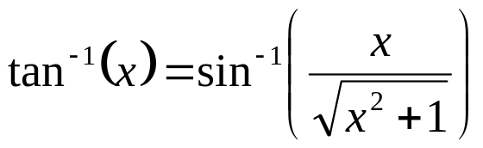
VFPU (4)
ATAN
  Atan satisfies
  Same kind of precision problem!
    Please, control the precision of your computation!
Use “interval arithmetic” to check your precision
Add precision with Newton-Raphson if possible
  Check once again the precision interval for each iteration
Other methods?
  Polynomial approximation
  Correction on some intervals?

Slide 69
VFPU (5)
LVR/LVL problem
  Loads for non aligned vectors
  1 lv.q becomes lvr+lvl
    2 instructions
    2 memory accesses
    IT DOESN’T WORK!
  DON’T USE IT because
    Hardware revision problem
    Future emulation problem
  1 lv.q becomes 4 lv.s
    4 instructions
    2 memory accesses (cache)
  When not using 4 components
    Less instructions!
WAW hazard
  Very hard to avoid ☹
  “Insert” cpu/fpu instructions
  Compiler’s job!
Dylan’s patch
  ASM vfpu register allocation support
  ASM vfpu vector and scalar sub-element access support
  Compiler 1.8 (soon?)

Slide 70
VFPU (6)
Dylan’s patch, intrinsic support
  sceePspGum::Translate()
  asm code
register vfpu_v4 vecS, vecD;
register vfpu_m4x4* pCurr;
pCurr = s_context.pCurr[mode];
vecS = vfpu_assign_float_into_v4x(vec->x, vec->y, vec->z, 1.0f );
vecD = vfpu_vhtfm4_q( *pCurr, vecS, VFPU_VD_E|VFPU_VS_X );
*pCurr = vfpu_insert_v4_into_m4w( *pCurr, vecD );
lw t3, 36(a1)
lw t0, 8(a0)
lw v0, 0(a0)
mtv v0, S000.s
mtv t4, S001.s
mtv t0, S002.s
lv.q C230.q, 48(t1)
lv.q C200.q, 0(t1)
lv.q C210.q, 16(t1)
lv.q C220.q, 32(t1)
vhtfm4.q C010.q, M200.q, C000.q
jr ra
sv.q C010.q, 48(t1)

Slide 71
VFPU (7)
Dylan’s patch, ASM support
sceePspGum::RotateX()
Advantages
  Compiler allocate vfpu registers
  Compiler minimize memory usage
register vfpu_m4x4 temp1;
register vfpu_m4x4 temp2;
__asm__
(
“ vMMOV.q %m1 , %m0 \n”
“ mtv %3 , %s0%:30 \n”
“ vCST.s %s0%:31, VFPU_2_PI \n”
“ vMUL.s %s0%:30, %s0%:30, %s0%:31 \n”
“ vIDT.q %c2%:00 \n”
“ vROT.q %c2%:10, %s0%:30, 9 \n”
“ vROT.q %c2%:20, %s0%:30, 22 \n”
“ vIDT.q %c2%:30 \n“
“ vMMUL.q %m0 , %m1 , %m2 \n”
:
"+j" (*pCurr),
"=j" (temp1),
"=j" (temp2)
:
"r" (angle)
);
__asm__
(
“ vMMOV.q M500, M700 \n”
“ mtv %0 , S730 \n”
“ vCST.s S731, VFPU_2_PI \n”
“ vMUL.s S730, S730, S731 \n” // Angle in hg
“ vIDT.q C600 \n”
“ vROT.q C610, S730, 9 \n”
“ vROT.q C620, S730, 22 \n”
“ vIDT.q C630 \n”
“ vMMUL.q M700, M500, M600 \n”
:
:
"r" (angle)
);

Slide 72
VFPU (8)
Dylan’s patch, mixing intrinsics and ASM
Because intrinsic cannot do everything!
  inline vfpu_v4 Normalize( vfpu_v4 sour )
  {
  register vfpu_v4 temp;
  register vfpu_v4 dest;
  // Load constants for normalization
  // (Can be factorized but I want to see how it is optimized by the compiler)
  temp = vfpu_vfim_s( 1.0f/2048.0f, VFPU_VD_X ); // "epsilon"
  temp = vfpu_vone_s_partial( temp, VFPU_VD_Y ); // 1.0f
  temp = vfpu_vdot_t_partial( temp, sour, sour, VFPU_VD_Y|VFPU_VS_XYZ|VFPU_VT_XYZ );
  temp = vfpu_vrsq_s_partial( temp, temp, VFPU_VD_Z|VFPU_VS_Z|VFPU_VT_Z );
  dest = vfpu_vscl_t_partial( dest, sour, temp, VFPU_VD_XYZ|VFPU_VS_XYZ|VFPU_VT_Z );
  return dest;
  }
  asm
  ( “ vCMP.s LT , %z0, %x0 \n” // c[0] = (S532 < 1/2048);
  “ vCMOVT.s %z0, %y0, 0 \n” // if (c[0]) S532 = 1.0f;
  : "+j" (temp) :
  );

Slide 73
VFPU (9)
Projections matrices =
4*4 matrices
4 quad words
(16 bytes)
Most game matrices =
4*3 matrices
3 quad words (12 bytes)
Transposition is free with VFPU!
  Read row rather than column!
  Example: Gum::Invert43()
Array Of Structures vs Structure Of Array
  Have a look at Intel publications
  Other platform math library
“Memory Bandwidth: The True Bottleneck of SIMD Multimedia Performance on a Superscalar Processor”,
Julien Sébot, Nathalie Drach-Temam
Do you really need inverse of 4*4 matrices?
x0 | x1 | x2 | x3
y0 | y1 | y2 | y3
z0 | z1 | z2 | z3
w0 | w1 | w2 | w3
x0 | x1 | x2 | x3
y0 | y1 | y2 | y3
z0 | z1 | z2 | z3
0 | 0 | 0 | 1

Slide 74
System optimization

Slide 75
System optimization
Use correct compiler options! (don’t laugh!)
Global optimization cost function?
  Maximize the game speed (Multi-criteria function)
Criteria
  Reduce the memory usage (CPU/VFPU/GE)
  Try to avoid to share the same bus
  (CPU/RAM versus GE/VRAM)
  Graphic data (texture, vertex arrays…) in VRAM can stall the GE because of the VRAM organization
  Global “balance” problem between sub-systems

Slide 76
Conclusions

Slide 77
Conclusions
You are now aware that memory accesses are important!
A lot of information here
  Manuals
  Presentations
    (https://psp-edu.scedev.net/projects/training)
  PSPTM forums
Share your experience with other developers!

